Slide 1
Contents
Gated Recurrent Unit (GRU)
GRU Application

Slide 2
Gated Recurrent Unit (GRU)
Similar to LSTM
Gates control the flow of information
New as compared to LSTMs
Simpler architecture as compared to LSTM
Relatively better performance as compared to LSTM
They do not have Cell State (C_{T}) and only have hidden state (H_{t})
They are faster to train
2

Slide 3
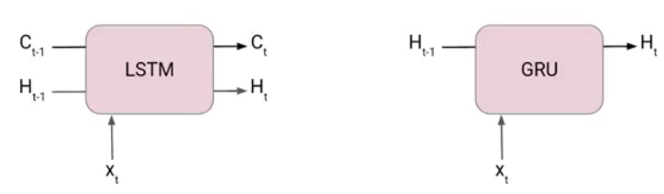
Gated Recurrent Unit (GRU)
Comparison between GRU and LSTM Block
We can clearly see there is no C_{T} (Cell memory) in GRU
At each timestamp t, it takes an input x_{t} and the hidden state h_{t-1} from the previous timestamp t-1.
It outputs a new hidden state h_{t} which again passed to the next timestamp.
There are two gates in a GRU as opposed to three gates in an LSTM cell. The first gate is the Reset gate and the other one is the update gate. In LSTM we have input, forget and update gates.
In LSTM we have two states Cell state or Long term memory and Hidden state also known as Short term memory. In the case of GRU, there is only one state i.e Hidden state (Ht).
3

Slide 4

Reset Gate (Short Term Memory)
The Reset Gate is responsible for the short-term memory of the network i.e the hidden state (h_{t}). Here is the equation of the Reset gate.
If you remember from the LSTM gate equation it is very similar to that. The value of r_{t} will range from 0 to 1 because of the sigmoid function. Here U_{r} and W_{r} are weight matrices for the reset gate.
$$r_{t}=σ⁡(H_{t−1}∗W_{r}+{x_{t}∗U}_{r})$$
4

Slide 5

Update Gate (Long Term Memory)
Similarly, we have an Update gate for long-term memory and the equation of the gate is shown below.
The value of u_{t} will range from 0 to 1 because of the sigmoid function. Here W_{u} and U_{u} are weight matrices for the update gate.
$$u_{t}=σ⁡({H_{t−1}∗W}_{u}+{x_{t}∗U}_{u})$$
5

Slide 6
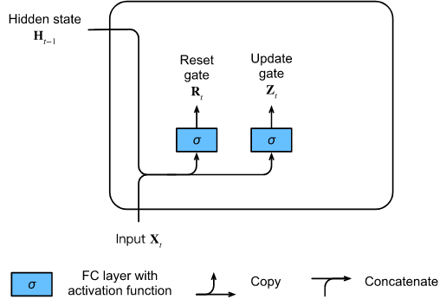


Gated Recurrent Unit (GRU)
$$R_{t}=σ⁡(W_{hr}H_{t−1}+W_{xr}X_{t}+b_{r})$$
$$Z_{t}=σ⁡(W_{hz}H_{t−1}+W_{xz}X_{t}+b_{z})$$

Slide 7
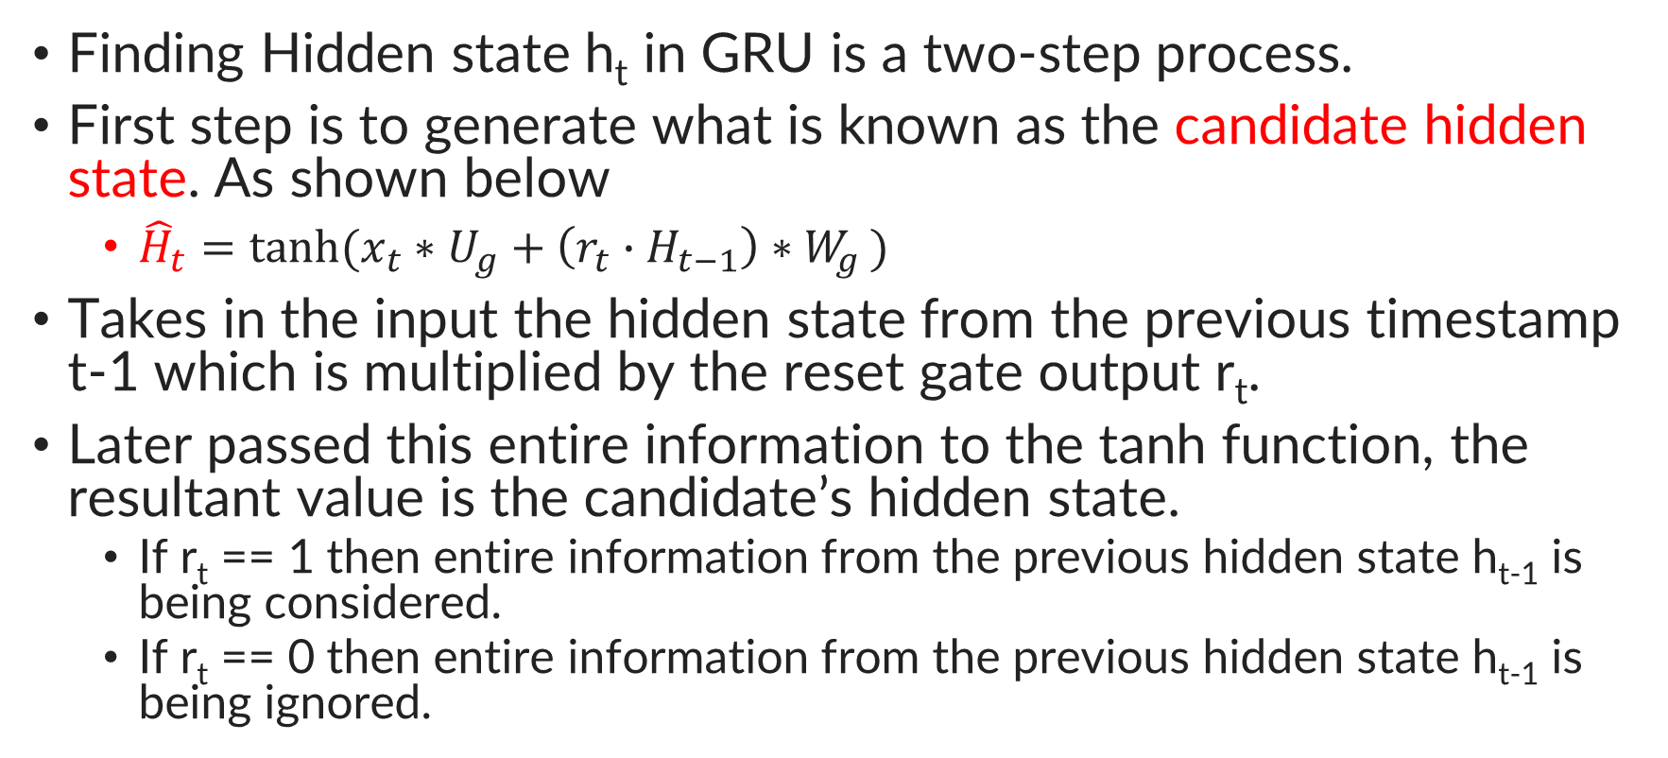
How GRU works?
Finding Hidden state h_{t} in GRU is a two-step process.
First step is to generate what is known as the candidate hidden state. As shown below
${\hat{H}}_{t}=\tanh{(x_{t}∗U_{g}+\left(r_{t}{∙H}_{t−1}\right)∗W_{g })}$
Takes in the input the hidden state from the previous timestamp t-1 which is multiplied by the reset gate output r_{t}.
Later passed this entire information to the tanh function, the resultant value is the candidate’s hidden state.
If r_{t} == 1 then entire information from the previous hidden state h_{t-1} is being considered.
If r_{t} == 0 then entire information from the previous hidden state h_{t-1} is being ignored.
7

Slide 8
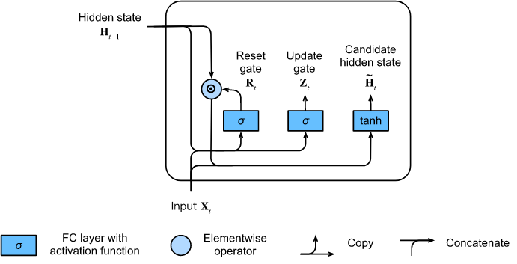

Candidate Hidden State
$$\hat{H_{t}}=tanh⁡(W_{hh}({R_{t}∙H}_{t−1})+W_{xh}X_{t}+b_{h})$$
Here we use a nonlinearity in the form of tanh to ensure that the values in the candidate hidden state remain in the interval (−1,1)(−1,1).

Slide 9
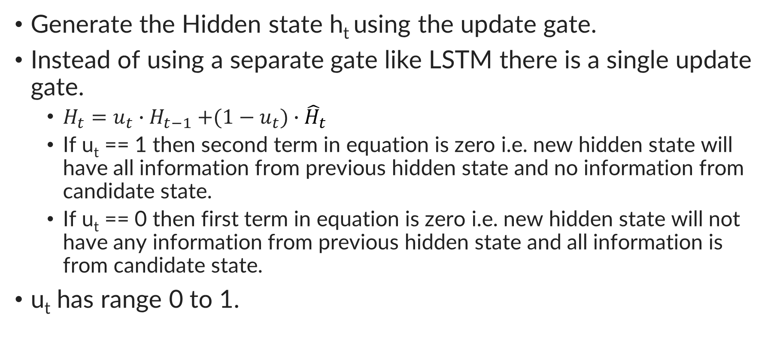
How GRU works?
Generate the Hidden state h_{t} using the update gate.
Instead of using a separate gate like LSTM there is a single update gate.
$H_{t}=$ $u_{t}{∙H}_{t−1}+(1−u_{t})$ $∙$ ${\hat{H}}_{t}$
If u_{t} == 1 then second term in equation is zero i.e. new hidden state will have all information from previous hidden state and no information from candidate state.
If u_{t} == 0 then first term in equation is zero i.e. new hidden state will not have any information from previous hidden state and all information is from candidate state.
u_{t} has range 0 to 1.
9

Slide 10
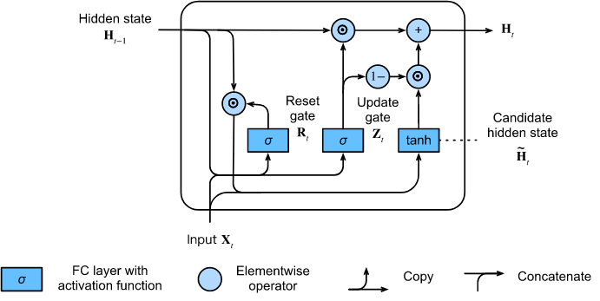

Hidden State
$$H_{t}={Z_{t}∙H}_{t−1}+{{(1−Z}_{t})∙\hat{H_{}}}_{t}$$

Slide 11
Implementation
Read time machine data set using pytorch
import torch
from torch import nn
from d2l import torch as d2l
batch_size, num_steps = 32, 35
train_iter, vocab = d2l.load_data_time_machine(batch_size, num_steps)

Slide 12
Implementation (Initializing Model Parameters)
def get_params(vocab_size, num_hiddens, device):
num_inputs = num_outputs = vocab_size
def normal(shape):
return torch.randn(size=shape, device=device) * 0.01
def three():
return (normal(
(num_inputs, num_hiddens)), normal((num_hiddens, num_hiddens)),
torch.zeros(num_hiddens, device=device))
W_xz, W_hz, b_z = three() # Update gate parameters
W_xr, W_hr, b_r = three() # Reset gate parameters
W_xh, W_hh, b_h = three() # Candidate hidden state parameters
# Output layer parameters
W_hq = normal((num_hiddens, num_outputs))
b_q = torch.zeros(num_outputs, device=device)
# Attach gradients
params = [W_xz, W_hz, b_z, W_xr, W_hr, b_r, W_xh, W_hh, b_h, W_hq, b_q]
for param in params:
param.requires_grad_(True)
return params

Slide 13
Implementation (Defining the Model)
def init_gru_state(batch_size, num_hiddens, device):
return (torch.zeros((batch_size, num_hiddens), device=device),)
def gru(inputs, state, params):
W_xz, W_hz, b_z, W_xr, W_hr, b_r, W_xh, W_hh, b_h, W_hq, b_q = params
H, = state
outputs = []
for X in inputs:
Z = torch.sigmoid((X @ W_xz) + (H @ W_hz) + b_z)
R = torch.sigmoid((X @ W_xr) + (H @ W_hr) + b_r)
H_tilda = torch.tanh((X @ W_xh) + ((R * H) @ W_hh) + b_h)
H = Z * H + (1 - Z) * H_tilda
Y = H @ W_hq + b_q
outputs.append(Y)
return torch.cat(outputs, dim=0), (H,)

Slide 14
Implementation (Training and Predicting)
vocab_size, num_hiddens, device = len(vocab), 256, d2l.try_gpu()
num_epochs, lr = 500, 1
model = d2l.RNNModelScratch(len(vocab), num_hiddens, device, get_params,
init_gru_state, gru)
d2l.train_ch8(model, train_iter, vocab, lr, num_epochs, device)

Slide 15
GRU Application
Sentiment Analysis using GRU
Goal is to classify a movie review as positive or negative
Consider the challenges related to the task
“This movie was not very good”. Very good is positive, however, (not) before very good makes the comment negative.
Neural Networks process numbers for triggering and not text.
In images, the size of image is fixed. Text can be of varying length.
All these challenges fall need to be addressed for Natural Language Processing
We shall use GRU to solve the problem of sentiment analysis
https://colab.research.google.com/github/Hvass-Labs/TensorFlow-Tutorials/blob/master/20_Natural_Language_Processing.ipynb#scrollTo=Y7oFtizmvRl3
15

Slide 16
Sentiment Analysis – Step1- Tokenization
Convert raw text into tokens
Tokens are integer values
Indices into a list of entire vocabulary
Tokenization is a way of separating a piece of text into smaller units called tokens.
Tokens can be either based upon words, characters, or subwords.
Generally, most popular tokenization is word level.
For example, consider the sentence: “Never give up”.
Tokenization of the sentence results in 3 tokens – Never-give-up. As each token is a word, it becomes an example of Word tokenization.
It can be thought of like assigning a number to each word
https://www.analyticsvidhya.com/blog/2020/05/what-is-tokenization-nlp/
16

Slide 17
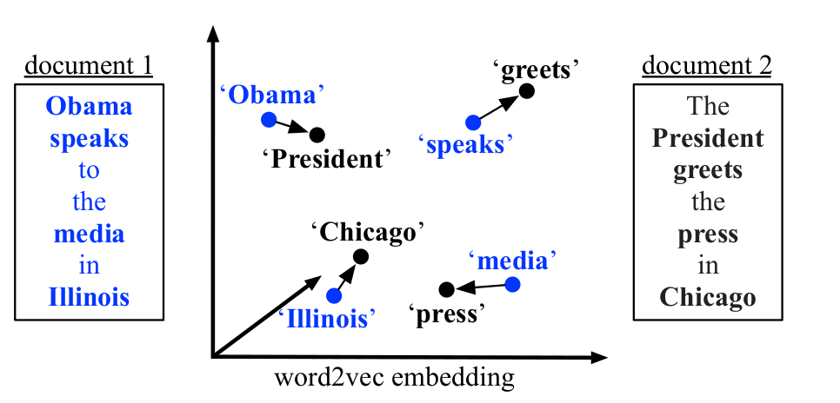
Sentiment Analysis – Step2- Word Embeddings
Convert integer tokens into word embeddings
They are used for representation of words for text analysis
Typically, in form of real-valued vector that encodes the meaning of the word
Encoding is such that, words with similar meaning are closer in vector space
Popular methods for word embedding
Embedding Layer
Word2vec
GloVe
https://machinelearningmastery.com/what-are-word-embeddings/
17

Slide 18
Sentiment Analysis – Step2- Word Embeddings
Word Embeddings – Embedding Layer
Requires that document text be cleaned and prepared such that each word is one-hot encoded.
Size of vector space is specified as part of the model, such as 50, 100, or 300 dimensions.
Vectors are initialized with small random numbers.
Embedding layer is used on the front end of a neural network and is fit in a supervised way using the Backpropagation algorithm.
One-hot encoded words are mapped to the word vectors.
This approach of learning an embedding layer requires a lot of training data and can be slow.
https://machinelearningmastery.com/what-are-word-embeddings/
18

Slide 19
Sentiment Analysis – Step2- Word Embeddings
Word Embeddings – Word2Vec
Word2Vec is a statistical method for efficiently learning a standalone word embedding from a text corpus.
Developed as a response to make the neural-network-based training of the embedding more efficient.
Analysis of learned vectors and exploration of vector math on the representations of words.
Bag of Words model learns the embedding by predicting the current word based on its context.
Advantage is that high-quality word embeddings can be learned efficiently (low space and time complexity), allowing larger embeddings to be learned (more dimensions) from much larger corpora of text (billions of words).
https://machinelearningmastery.com/what-are-word-embeddings/
19

Slide 20
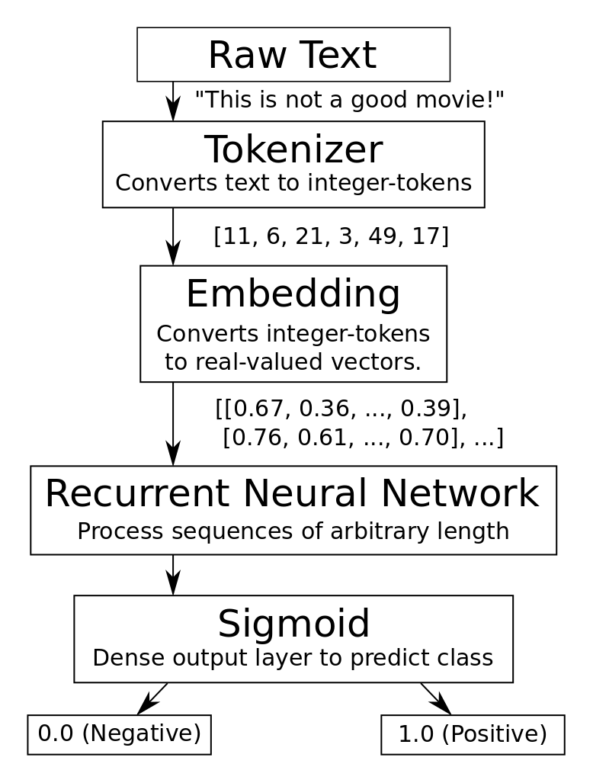
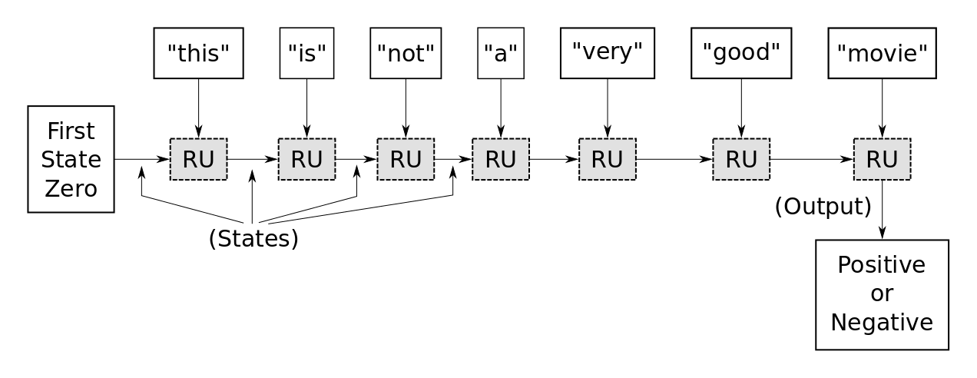
Sentiment Analysis – Step3- RNN
Input embeddings to RNN (GRU)
Output obtained using Sigmoid function
Output between range 0.0 and 1.0
0.0 indicates a negative comment
1.0 indicates a positive comment
Basic unit of RNN is Recursive Unit (RU)
Another way to visualize RNN is to unroll recursion
Third word is important as it is “not”
At time step 6 the word “good” is important
20

Slide 21
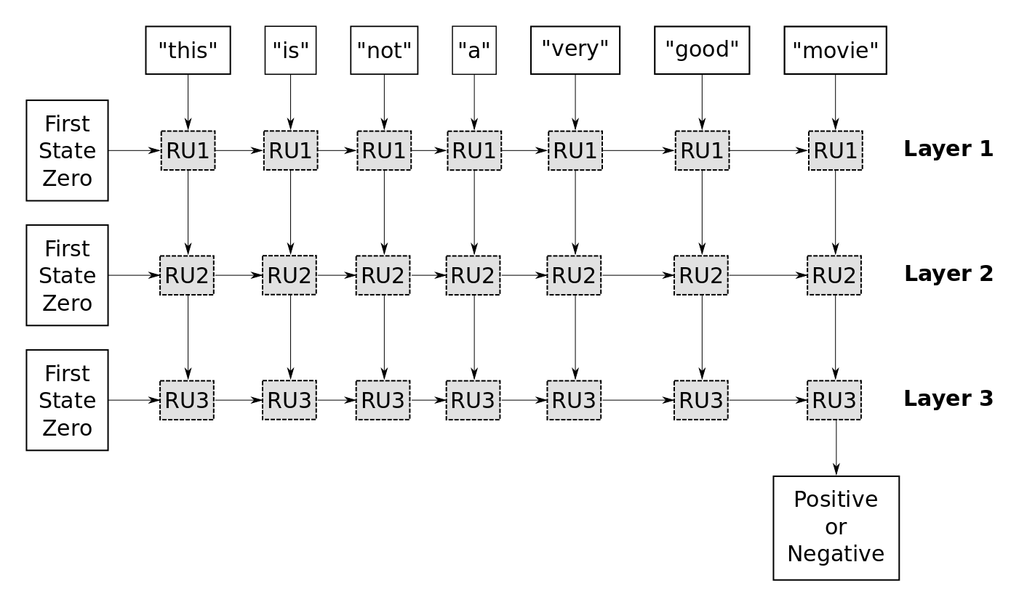
Sentiment Analysis – 3 Layer RNN
1st layer is like the unrolled single-layer RNN.
1st recurrent unit RU1 has its internal state initialized to zero.
The word "this" is input to RU1 and it updates its internal state.
Then it processes the next word "is", and so forth.
We use the output of RU1 for every time-step.
This creates a new sequence that can then be used as input for the next recurrent unit RU2.
Same process is repeated for the subsequent layers.
Output of RU3 is passed to fully-connected Sigmoid
layer that outputs value between 0.0 (-ve) and 1.0 (+ve).
21

Slide 22
Sentiment Analysis – Example
In this example we will use texts that have more than 500 words.
This means the RU's gate for updating its internal memory-state is applied recursively more than 500 times.
If a gradient of just 1.01 is multiplied with itself 500 times then it gives a value of about 145. If a gradient of just 0.99 is multiplied with itself 500 times then it gives a value of about 0.007.
These are called exploding and vanishing gradients. The only gradients that can survive recurrent multiplication are 0 and 1.
To avoid these so-called exploding and vanishing gradients, care must be made when designing the recurrent unit and its gates.
That is why the actual implementation of the GRU is more complicated, because it tries to send the gradient back through the gates without this distortion.
22

Slide 23
Sentiment Analysis – Imports
%matplotlib inline
import matplotlib.pyplot as plt
import tensorflow as tf
import numpy as np
from scipy.spatial.distance import cdist
from tensorflow.keras.models import Sequential
from tensorflow.keras.layers import Dense, GRU, Embedding
from tensorflow.keras.optimizers import Adam
from tensorflow.keras.preprocessing.text import Tokenizer
from tensorflow.keras.preprocessing.sequence import pad_sequences
23
Notes:
Adam optimizer

Slide 24
Sentiment Analysis – Load Data
from imdb import IMDb
imdb.maybe_download_and_extract() #Data size is 84MB download and extract
x_train_text, y_train = imdb.load_data(train=True)#Load training and test sets
x_test_text, y_test = imdb.load_data(train=False)
# Convert to numpy arrays.
y_train = np.array(y_train)
y_test = np.array(y_test)
data_text = x_train_text + x_test_text #Combine into one dataset
x_train_text[1] #display the first text in the dataset
y_train[1] #1.0 (Positive Sentiment)
24

Slide 25
Sentiment Analysis – Tokenizer
num_words = 10000 #Use only the top 10000 most frequently occurring words
tokenizer = Tokenizer(num_words=num_words)
tokenizer.fit_on_texts(data_text)
#The tokenizer can then be "fitted" to the data-set. This scans through all the text and strips it from unwanted characters such as punctuation, and also converts it to lower-case characters. The tokenizer then builds a vocabulary of all unique words along with various data-structures for accessing the data.
#Note that we fit the tokenizer on the entire data-set so it gathers words from both the training- and test-data. This is OK as we are merely building a vocabulary and want it to be as complete as possible. The actual neural network will of course only be trained on the training-set.
if num_words is None:
num_words = len(tokenizer.word_index)
25

Slide 26
Sentiment Analysis – Tokenizer
#Inspect vocabulary of tokenizer
tokenizer.word_index
#{'the': 1, 'and': 2, 'a': 3, 'of': 4, 'to': 5, 'is': 6, 'br': 7, 'in': 8, 'it': 9, 'i': 10,
'telling': 997, 'cover': 998, 'outside': 999, 'present': 1000, ...}
#Use tokenizer to convert all texts in training text to list of tokens
x_train_tokens = tokenizer.texts_to_sequences(x_train_text)
x_train_text[1]
#Return To the Lost World was filmed back-to-back with the 1992 version
np.array(x_train_tokens[1])
#array([1037, 5, 1, 432, 181, 13, 748, 141, 5, 141, 16,
1, 7418, 318, 4, 1, 432, 181, 7, 7, 8, 11,
751, 1, 167, 707, 83, 469, 31, 1037, 5, 1, 117,
x_test_tokens = tokenizer.texts_to_sequences(x_test_text)
26

Slide 27
Sentiment Analysis – Padding and Truncation
RNN can take sequences of arbitrary length as input, but in order to use a whole batch of data, the sequences need to have the same length.
Two ways of achieving this:
Either we ensure that all sequences in the entire data-set have the same length
We write custom data-generator that ensures that sequences have same length within each batch.
Solution (A) is simpler but if we use the length of the longest sequence in the data-set, then we are wasting a lot of memory.
So, we will use a sequence-length that covers most sequences in the data-set, and we will then truncate longer sequences and pad shorter sequences.
First count the number of tokens in all the sequences in the data-set.
num_tokens = [len(tokens) for tokens in x_train_tokens + x_test_tokens]
num_tokens = np.array(num_tokens)
27

Slide 28
Sentiment Analysis – Padding and Truncation
Calculate average and maximum number of tokens in dataset
np.mean(num_tokens)
np.max(num_tokens)
Set maximum number of tokens to average plus 2 standard deviation covering 95% data
max_tokens = np.mean(num_tokens) + 2 * np.std(num_tokens)
max_tokens = int(max_tokens)
max_tokens
np.sum(num_tokens < max_tokens) / len(num_tokens) #0.94528
28

Slide 29
Sentiment Analysis – Padding and Truncation
Determine if padding or truncating 'pre' or 'post’ is required.
If a sequence is truncated, it means that a part of the sequence is simply thrown away.
If a sequence is padded, it means that zeros are added to the sequence.
pad = 'pre'
x_train_pad = pad_sequences(x_train_tokens, maxlen=max_tokens,padding=pad, truncating=pad)
x_test_pad = pad_sequences(x_test_tokens, maxlen=max_tokens,padding=pad, truncating=pad)
x_train_pad.shape #(25000, 544)
x_test_pad.shape #(25000, 544)
Data given below
array([1037, 5, 1, 432, 181, 13, 748, 141, 5, 141, 16, 1, 7418, 318, 4, 1, 432, 181, 7, 7, 8, 11, 751, 1, 167, 707, 83, 469, 31, 1037, 5, 1, 117, 3, 547, 45, 654,
After Padding
array([ 0, 0, 0, 0, 0, 0, 0, 0, 0, 0, 0, 0, 0, 0, 0, 0, 0, 0, 0, 0, 0, 0, 0, 0, 0, 0, 0, 0, 0, 0, 0, 0, 0, 1037, 5, 1, 432, 181, 13, 748, 141, 5, 141, 16, 1, 7418, 318, 4, 1, 432, 181, 7, 7, 8, 11, 751, 1, 167, 707, 83, 469, 31, 1037, 5, 1, 117, 3, 547, 45, 654,
29

Slide 30
Sentiment Analysis – Inverse Tokenizer
Function for converting tokens back to string.
def tokens_to_string(tokens):
words = [inverse_map[token] for token in tokens if token != 0]#Map from tokens to words.
text = " ".join(words) # Concatenate all words.
return text
Print and compare original text and text generated by inverse tokenization
x_train_text[1]
'Return To the Lost World was filmed back-to-back with the 1992 version
tokens_to_string(x_train_tokens[1])
'return to the lost world was filmed back to back with the 1992 version
30

Slide 31
Sentiment Analysis – Create RNN
1st layer in RNN is Embedding-layer (converts integer-token into a vector of values).
Necessary because integer-tokens may have values between 0 and 10000 for a vocabulary of 10000 words.
RNN cannot work on values in such a wide range. Embedding-layer will map words with similar semantic meanings to similar embedding-vectors.
First, we define the size of the embedding-vector for each integer-token.
In this case we have set it to 8, so that each integer-token will be converted to a vector of length 8.
Values of embedding-vector will be between -1.0 and 1.0, although they may exceed these values somewhat.
Pass number of words in vocabulary and length of padded token to embedding layer
model = Sequential()
embedding_size = 8
model.add(Embedding(input_dim=num_words,
output_dim=embedding_size,
input_length=max_tokens,
name='layer_embedding'))
31

Slide 32
Sentiment Analysis – Create RNN
Add a GRU with 16 outputs
model.add(GRU(units=16, return_sequences=True))
Add a second GRU with 8 outputs
model.add(GRU(units=8, return_sequences=True))
Add a third GRU with 4 outputs. This will be connected to dense layer hence it give final output of GRU
model.add(GRU(units=4))
Add a fully-connected / dense layer which computes a value between 0.0 and 1.0 that will be used as the classification output.
model.add(Dense(1, activation='sigmoid'))
Use the Adam optimizer with the given learning-rate.
optimizer = Adam(lr=1e-3)
32

Slide 33
Sentiment Analysis – Create RNN
Compile the Keras model
model.compile(loss='binary_crossentropy',
optimizer=optimizer,
metrics=['accuracy’])
model.summary()
Model: "sequential"
___________________________________________________
Layer (type) Output Shape Param #
===================================================
layer_embedding (Embedding) (None, 544, 8) 80000
___________________________________________________
gru (GRU) (None, 544, 16) 1248
___________________________________________________
gru_1 (GRU) (None, 544, 8) 624
___________________________________________________
gru_2 (GRU) (None, 4) 168
___________________________________________________
dense (Dense) (None, 1) 5
===================================================
Total params: 82,045
Trainable params: 82,045
Non-trainable params: 0
___________________________________________________
33

Slide 34
Sentiment Analysis – Train RNN
Train the Keras model
model.fit(x_train_pad, y_train, validation_split=0.05, epochs=3, batch_size=64)
Train on 23750 samples, validate on 1250 samples
Epoch 1/3
23750/23750 [==============================] - 16s 690us/sample - loss: 0.4935 - accuracy: 0.7452 - val_loss: 0.3798 - val_accuracy: 0.8328
Epoch 2/3
23750/23750 [==============================] - 12s 510us/sample - loss: 0.2919 - accuracy: 0.8887 - val_loss: 0.3111 - val_accuracy: 0.8736
Epoch 3/3
23750/23750 [==============================] - 12s 511us/sample - loss: 0.2210 - accuracy: 0.9211 - val_loss: 0.3090 - val_accuracy: 0.8760
CPU times: user 48.9 s, sys: 1.58 s, total: 50.5 s
34

Slide 35
Sentiment Analysis – Test the system
Test on the test data set
result = model.evaluate(x_test_pad, y_test)
25000/25000 [==============================] - 12s 493us/sample - loss: 0.3331 - accuracy: 0.8674
CPU times: user 14 s, sys: 404 ms, total: 14.4 s Wall time: 12.4 s
print("Accuracy: {0:.2%}".format(result[1])) #86.74%
35

